Slide 1
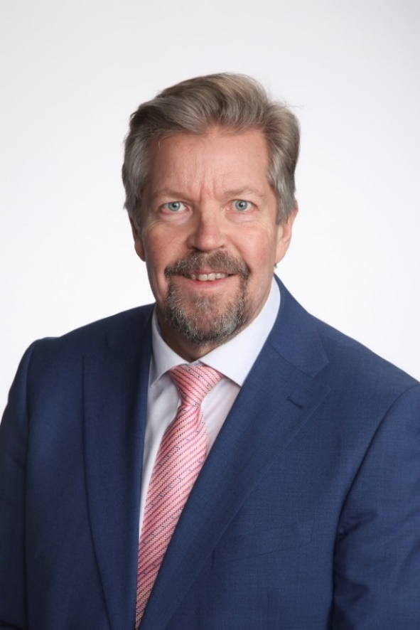
Conference Skills Lithuania:
Futureproof employment and citizenship
21 November 2023, Vilnius Lithuania
Panel 3: Futureproof employment and citizenship: promoting lasting careers through Lifelong learning (LLL)
Mr. Esa Karvinen, Principal of Riveria (FINLAND)
- Riveria is one of largest VET centers in Finland (about 17.000 students)
34 years experience of VET education
- VET teacher, trainer of the year in Finland
management positions for 30 years in VET educational institutions
former Director of VET at the Finnish National Agency for Education
Honorary Consul of Lithuania in Finland
Finland
esa.karvinen@riveria.fi
tel. +358 50 327 8191

Slide 2
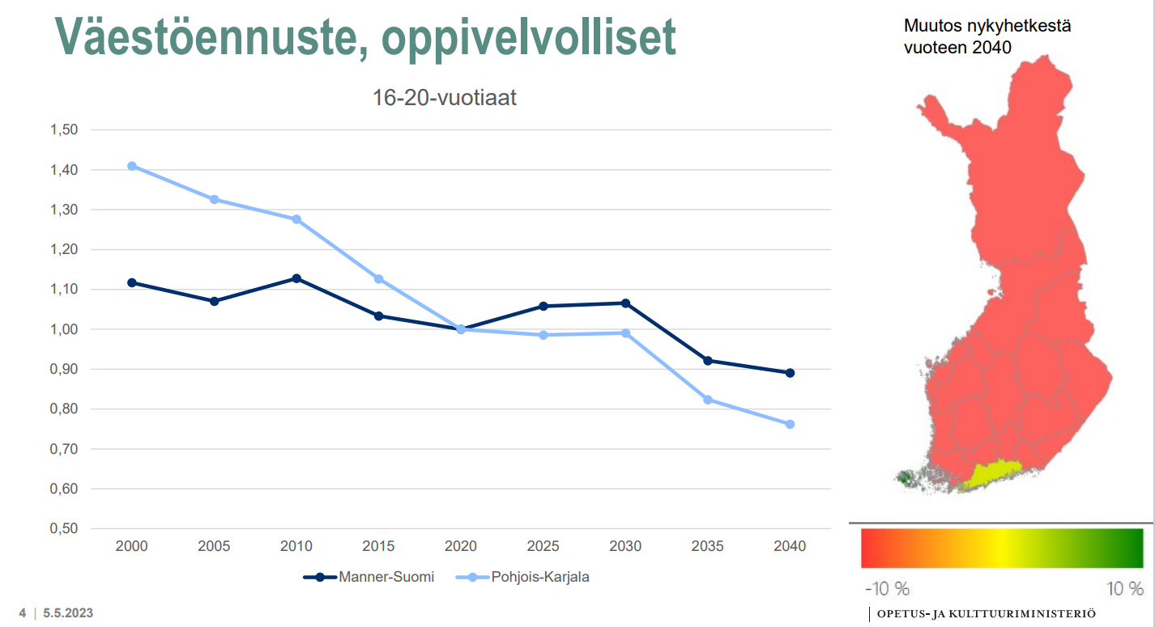
Change from today to 2040
Population development in Finland
16-20 year olds
Continental
Finland
North Karelia

Slide 3
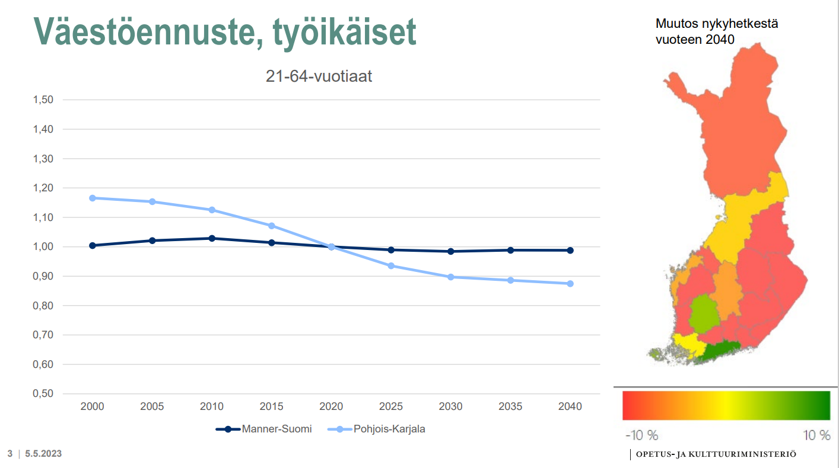
Change from today to 2040
Population development in Finland
21-64 year olds
Continental
Finland
North Karelia

Slide 4
Education system in Finland
Notes:
Education system in Finland (okm.fi)

Slide 5
Financing of VET
Government
Ministry of Education and Culture
Education providers
Municipalities
Municipalities
Joint municipal
authorities
Private providers
Registered associations
Registered foundations
Limited companies
State institutes
Tax-funding

Slide 6
Distribution of funding between municipalities and the state 2023
Financing item | Euros
Total appropriation for vocational training | 2 022 025 000
Share of imputed financing of which the share of basic funding (70 %) of which the share of performance financing (20 %) of which the share of effectiveness funding (10 %) | 2 007 025 000 1 404 918 000 401 405 000 200 702 000
Strategic financing | 15 000 000
Municipalities' financial contribution | 1 050 613 000
Compensations (state’s share) | 41 883 000
State’s financial contribution | 1 013 295 000

Slide 7
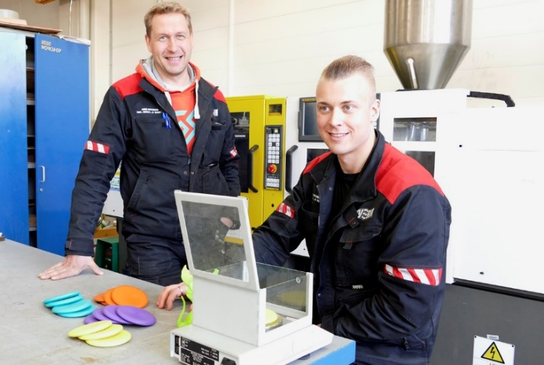
Funding system for VET
50%
35%
Ennen 100 %
BASIC FUNDING
– student years
Creates
– the preconditions for making training available for all industries and students
– a predictable foundation for providing degrees and training
PERFORMANCE FUNDING
– degrees and parts thereof
Guides and encourages
– to allocate training and degrees in accordance with the competence requirements
– to make the learning processes more efficient
– to complete degrees and parts thereof according to the set targets
15%
EFFICIENCY FUNDING
– employment, further studies, feedback

Slide 8
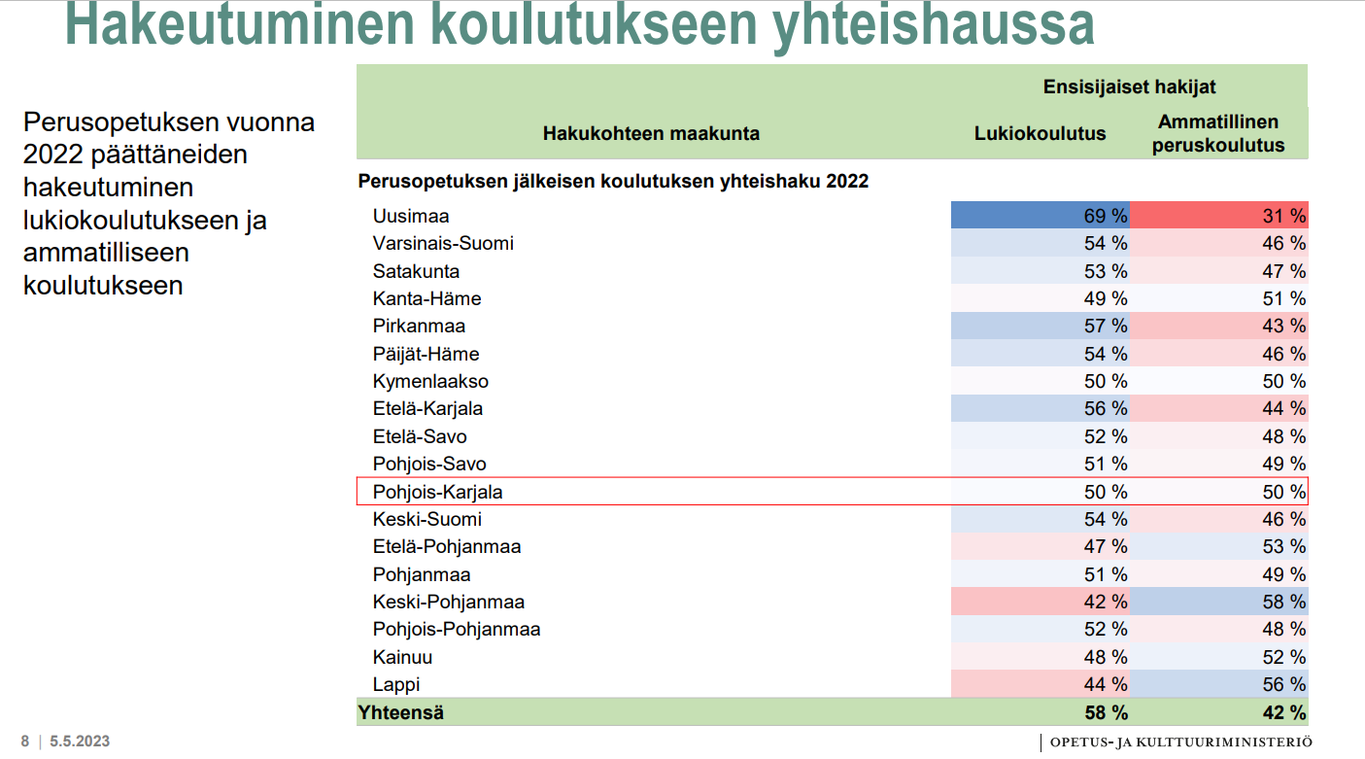
Applying for training via joint application system
Those who finished comprehensive school education in 2022 applying for upper secondary school education and vocational education training
General upper secondary education
Vocational education and training
Region
Joint application system after comprehensive school 2022
(North Karelia)

Slide 9
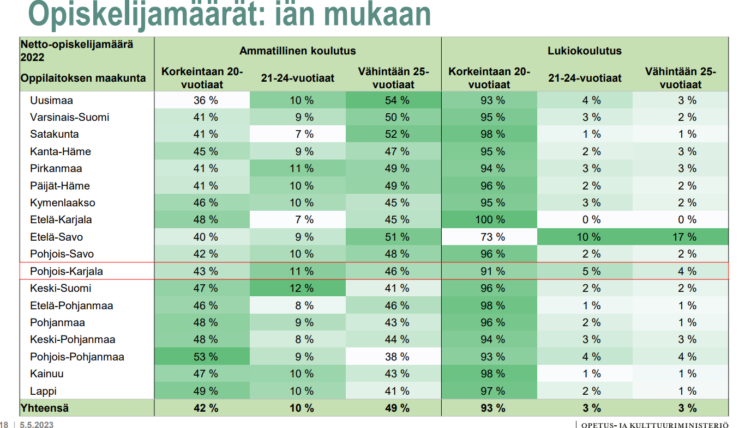
Number of students by age
Vocational education and training
General upper secondary education
≤ 20 year old
21-24 year old
≥ 25 year old
≤ 20 year old
21-24 year old
≥ 25 year old
Region
(North Karelia)

Slide 10
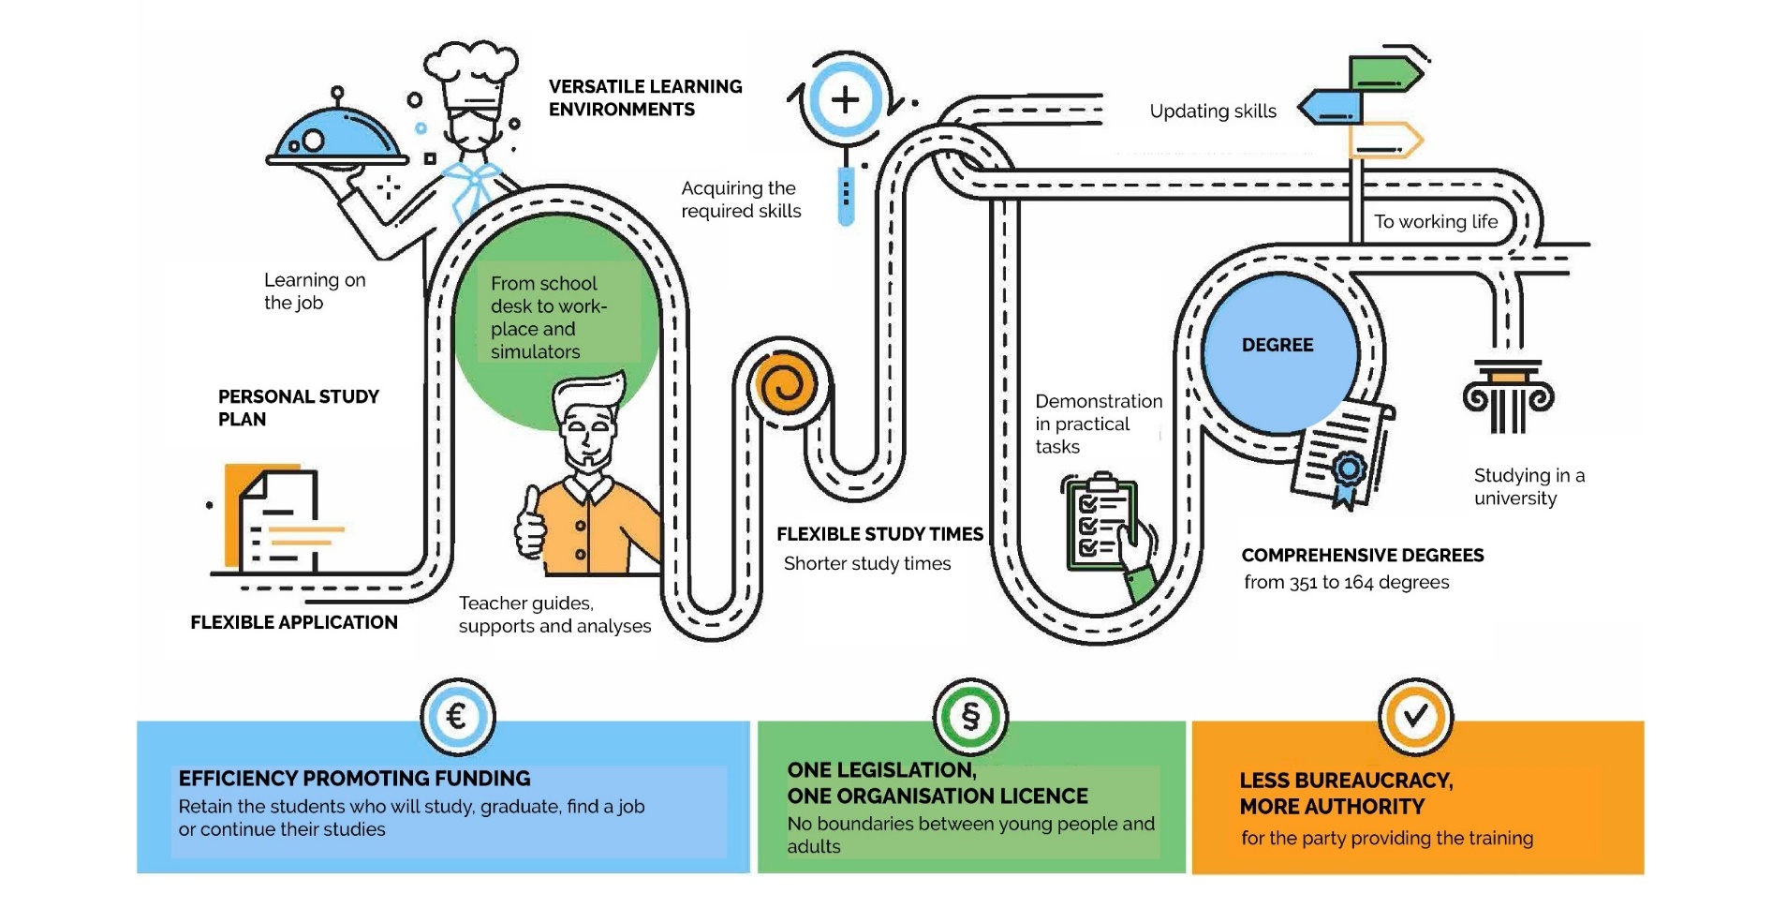
Vocational education and
Training in Finland 2018 -
Finnish Vocational Education and Training (VET) video on YouTube:
https://youtu.be/mzRklnHP5iU
Ennen 100 %

Slide 11
The foundation of Finnish VET
Respected and attractive (everyone has an opportunity to participate)
Highly educated and respected teaching personnel (1500 hours / year)
Ministry of Education gives permission to independent providers (140)
Funding comes mainly from the Ministry of Education
National level qualification evaluation and development together with working life (one demonstration-based way to get a degree)
A personal skill development plan for each student
(based on competences, not time)
Education is developed in partnerships (working life, authorities, students, teachers, parents, research, social partners, stakeholders)
The aim is to get students employed and to get skilled workforce (everyone can continue their studies at Universities or Universities of Applied Sciences)
Education is free of charge, including one meal during the day and possibly a student dormitory

Slide 12
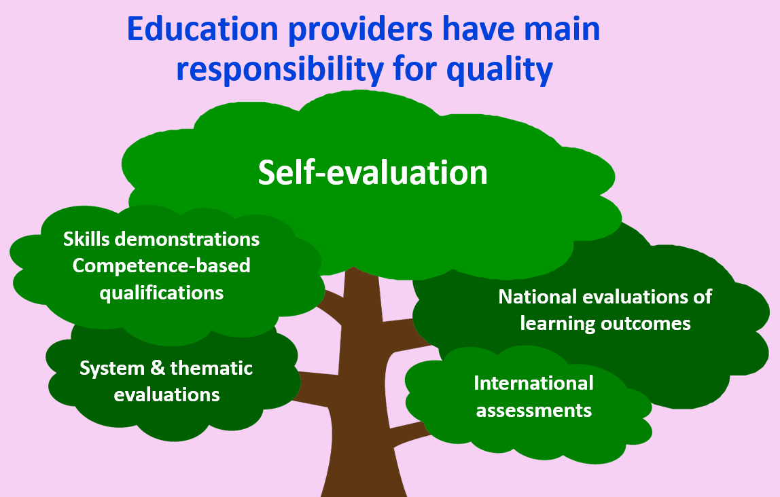

Slide 13
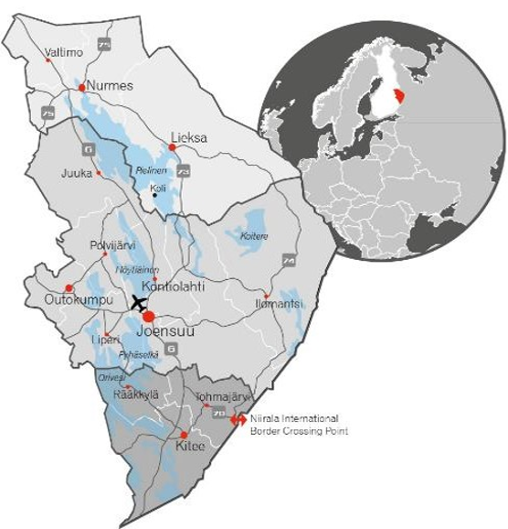
Students 17.000/year
VET qualifications 100
Staff 700
Finland’s most skilled students
Quality Award in VET
Operating income 70 mill.€
Facilities 100.000 m²
Investments 10 mill.€/year
Vehicles and machinery 300
Student accommodation 600
Computers 3.200
6 % entrepreneurs
Foreign students
400/year
Learning workplaces 11.000
Student and worklife
excellent feedback
90 %
gets a job in North Karelia
70 %
employed
10 % postgraduate
studies
Owners 12 municipalities, VET units 6
@esakarvinen

Slide 14
North Karelia Municipal Education and Training Consortium
1.9.2023
Competent professionals
Limited Company
In the competitive education market
COUNCIL
Chairperson Mr Ville Toivanen (52 members)
BOARD
Chairperson Ms Sanna Rissanen (11 members)
Audit Committee
Director, Principal Mr Esa Karvinen
Kuntayhtymän johtaja, rehtori
Pedagogical Director Ms Jatta Herranen
Education and Training
Business Services Manager Ms Suvi Valoharju
Cooperation with Working Life
Administrative Director Ms Merja Laituri-Korhonen
Administrative and Financial Services
Human Resources and Communications Director Mr Teemu Kokko
Human Resources and Communications Services
HYVINVOINTI JA TERVEYS
Koulutusjohtaja
Tiimipäälliköt
Sosiaali- ja terveysala
Kasvatus- ja ohjausala
Kulttuuriala
Tutkintokoulutus
Pedagoginen johtaja Jatta Herranen
Työelämäyhteistyö
Yrityspalvelupäällikkö
Hallinto- ja talouspalvelut
Hallintojohtaja
Henkilöstö- ja viestintä- palvelut
Henkilöstö- ja viestintä- johtaja
Education Director Mr Jere Mutanen
WELL-BEING AND HEALTH
Team Manager
Teaching staff
Education Director Mr Pasi Kuuluvainen
INDUSTRY AND BIOECONOMY
Team Manager
Teaching staff
Education Director Ms Jaana Rajavuori
SERVICES
Team Manager
Teaching staff
Education Director Mr Antti Pietarinen
CONSTRUCTION
Team Manager
Teaching staff
STUDENTS
STAFF
Responsibility Customer orientation Effectiveness

Slide 15
Our organisation
We organise multidisciplinary education and training in the region of North Karelia, Eastern Finland.
Training units: Joensuu // Kitee // Lieksa // Nurmes // Outokumpu // Valtimo
Four sectors
Well-being and Health Social and healthcare Education and guidance
Culture
Construction
Mining, earthwork and infrastructure construction| Building maintenance technology | Building construction, wood and surface treatment technology | Automation, electric and process technology | Security and property services| Information and communications technology
Services
Business and entrepreneurship Food industry, restaurant and catering services Hairdressing and beauty care Tourism
Hyvinvointi ja terveys
Sosiaali- ja terveysala Kasvatus- ja ohjausala
Kulttuuriala
Industry and Bioeconomy Forestry | Machinery, metal and plastic sector | Motor vehicle technology | Agriculture | Logistics

Slide 16
Process of VET provision
We have the full autonomy to decide how we are implementing the requirements of the legislation and the national targets into practice.
The Ministry of Education and Culture is steering the implementation by information (VET policy) and the allocation of funding.
Riveria has permission to organize VET in 97 degrees from our Ministry of Education and Culture:
Basic vocational Qualifications: 34 degrees in different fields of VET.
Further vocational Qualifications: 39 degrees in different fields of VET.
Special vocational Qualifications: 24 degrees in different fields of VET.
In Riveria, it’s our choice to determine how many experts we educate every year, for example practical nurses, welders and other VET experts of those 97 VET degrees.
We are organizing about 5.600 student years (licence based)

Slide 17
Study places and applicants 2023
 | Study places 2023 | Joint application process 2023 – primary applicants | Joint application process – all applicants | Continuous application process, applicants January – July 2023
Initial vocational qualification | 2077 | 1042 | 3843 | 6159
TUVA – preparatory training for vocational qualification programmes | 100 | 43 | 223 | 167
Further vocational qualifications | 961 |  |  | 810
Specialised vocational qualifications | 384 |  |  | 138
Other (open applications, apprenticeships) |  |  |  | 240
TOTAL | 3522 | 1085 | 4066 | 7514

Slide 18
VET - Riveria’s core process
Teaching and supervision locally at the VET Consortium
Learning in working life and guidance in the workplace
Online teaching and guidance not dependent on time and place
Educational provision planning
Recruiting students
Acquiring competence
Degree certificate (or part)
Planning missing competence acquisition and demonstration
Demonstration and assessment of competence
Identification and recognition prior competence
Student application
Student selection
1
4
5
6
10
2
3
7
8
9
Employment
(postgraduate studies)
Personalization of studies
Personal competence development plan
What? How? Where? When?

Slide 19
LEARNING ENVIRONMENTS
Teaching classrooms and operational environments at school
Distance learning
On-the-job learning

Slide 20
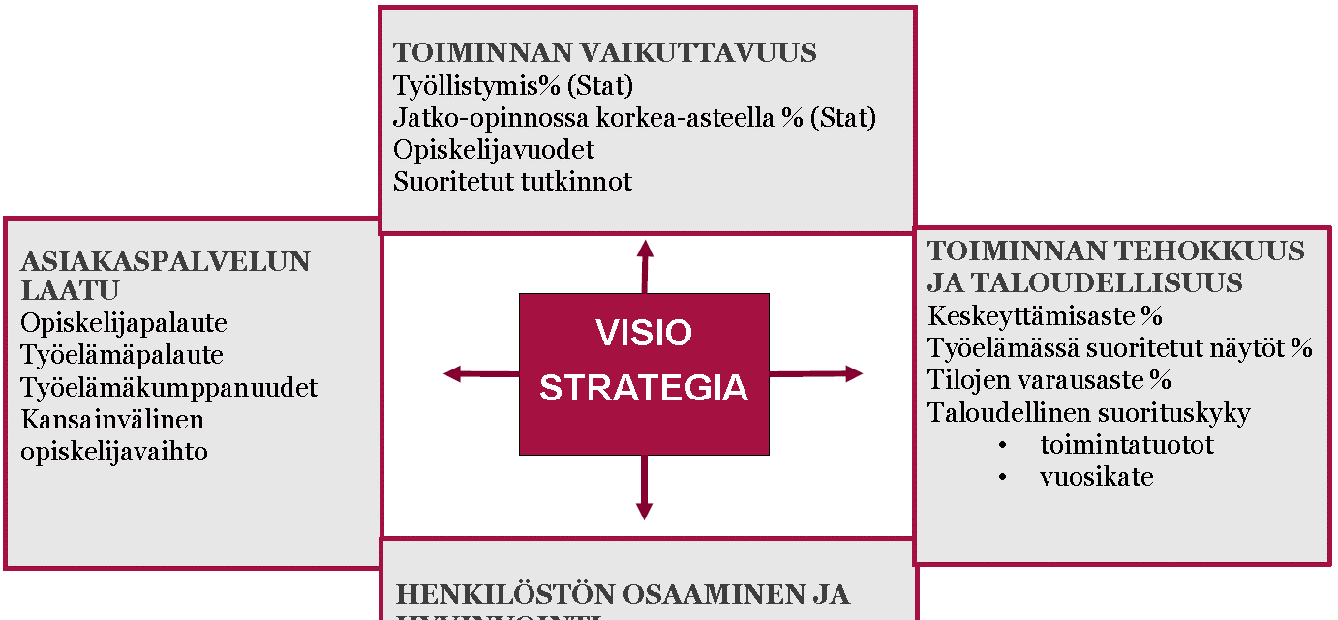
Daily BSC – indicators and assessment
EFFECTIVENESS OF OPERATIONS
Employment % (Stat)
Further studies at a high level % (Stat)
Student years
Completed degrees
OPERATIONAL EFFICIENCY
AND COST-EFFECTIVENESS
Drop-outs %
Demonstrations performed at work %
Facility booking level %
Financial performance
operational profits
annual margin
CUSTOMER SERVICE QUALITY
Student feedback
Work life feedback
Work life partnerships
International student exchange
VISION
STRATEGY
EMPLOYEES’ COMPETENCE AND WELL-BEING
Personnel’s competence development
percentage of HR expenses %
working life periods
Employee well-being
atmosphere survey results

Slide 21
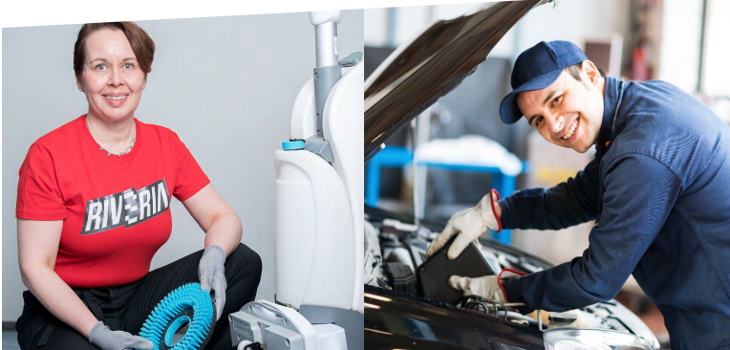
Working life cooperation
in Riveria
Education and development is always made together with companies and employers
What quolifications and how many per year is provided (decision makers are providers with companies)
About half on studies happens inside companies (study agreement, apprenticeship 80 %)
VET education is not based on time, it is based on compentences
Degree is demonstration based, student shows their compentences inside companies
Compentence assessment is made together by the teacher and a representative of company (2 persons)
Providers might have also holistic partnership agreements with companies (all services, equipments)
Custom compentence evalution of teacher´s team by company leaders (face to face)
esa.karvinen@riveria.fi

Slide 22
PARTNERSHIP AGREEMENT
Comprehensively solve the partner’s competence requirements
One contact person
Systematic and target-oriented cooperation
Offer all degree and
education services
Provide added value for the customer

Slide 23
PARTNERSHIP AGREEMENTS (EXCAMPLES)
Invalidiliiton Asumispalvelut Oy / Validia asuminen
JKP Talohuolto- palvelut Oy
John Deere Forestry
Juuka

Slide 24
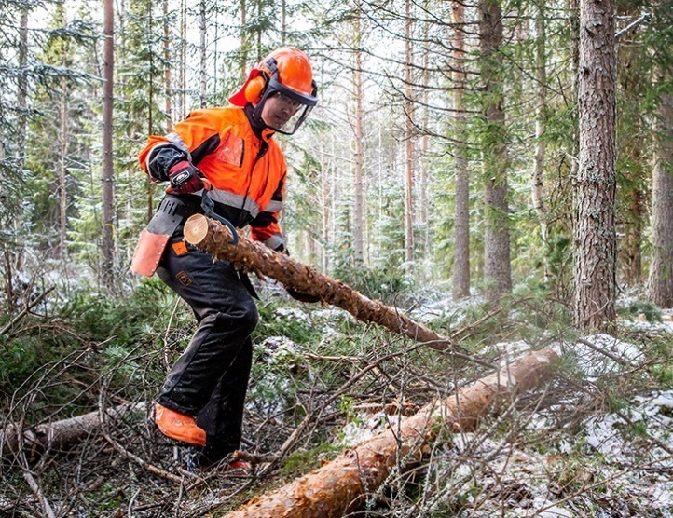
Network think tank North Karelia, approx. 1,200 respondents
The most important thing in the future VET will be
to meet the needs of working life.
Importance Quantity
Meeting the needs of business life
Quality in learning and teaching
On-the-job learning Effectiveness and looking after student
Flexible personal education
Internal and external cooperation Regeneration and pioneering
Comprehensive supply in each area
66
67
68
69
70
71
72
73
74

Slide 25
THE GOVERNMENTAL PROGRAMME, NEW 2023 (VET)
The focus of funding shifts more to students’ degrees and employment / transfer to postgraduate studies.
Sector-specific education must be evaluated and valued in a new way to meet the needs of working life.
The share of qualification units and shorter-than-a-qualification education programs in the total volume will increase significantly.
The logic of the vocational education and training is being transformed in the education for adults.
Stronger teaching, guidance and support for compulsory education (young students).
Funding for education will be allocated to the organizers of the education in a different way.

Slide 26
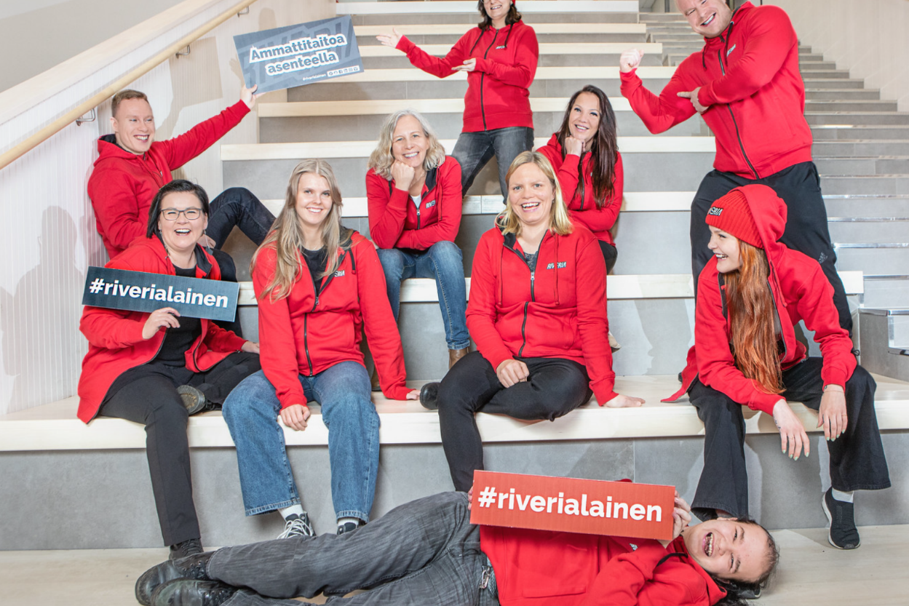
Always present to the learner and open to working life.

